Slide 1
Exploratory Analysis of Mesa County Public Health
By Kurtis Bulock

Slide 2
Observations
Representation of Race Survey vs. County
Loneliness vs. Social Conflict
All ages
Children
Household Income vs. Household Danger
Household Income vs. Social Conflict
Future Work
Possible continued observations
How this information can be used for action

Slide 3
Racial Representation (single race)
Race | Survey Representation | County Representation
Asian | 0.742% | 1.036%
Black/African American | 1.372% | 0.948%
Native American/Alaska Native | 5.193% | 1.534%
Native Hawaiian/Other Pacific Islander | 0.297% | 0.137%
White | 92.40% | 93.94%
Native American/Alaska Natives overrepresented
Other races are nearly accurately represented

Slide 4
Racial Representation Future Work
Minorities in the community.
Compare diversity in Mesa County to other Colorado counties.
How does the diversity of CMU compare to the rest of the County?

Slide 5
Loneliness and Social Conflict
Loneliness is reported by Supplemental Need Family & Community Support Answer
Loneliness is measured on a scale of 0-4
[0] NEVER
[1] RARELY
[2] SOMETIMES
[3] FAIRLY OFTEN
[4] ALWAYS
Social Discourse is measured out of a total of 16 by adding all of the Core Need Safety answers 1-4
CN_SF_1-4 are measured by the following
[0] NEVER
[1] RARELY
[2] SOMETIMES
[3] FAIRLY OFTEN
[4] FREQUENTLY

Slide 6
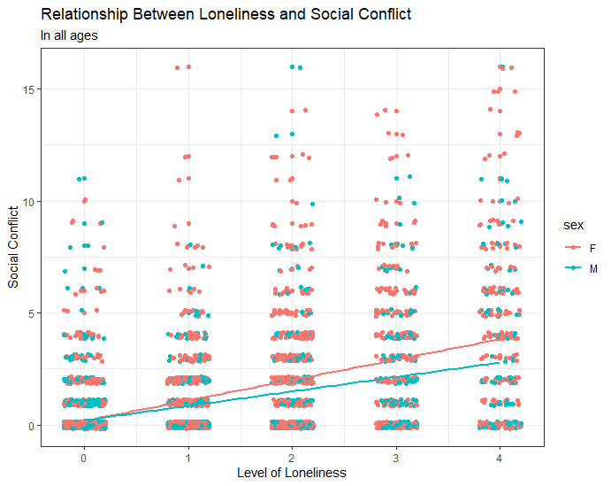
Loneliness and Social Conflict
Higher social conflict correlates with a higher feeling of loneliness
Reporting higher loneliness in women

Slide 7
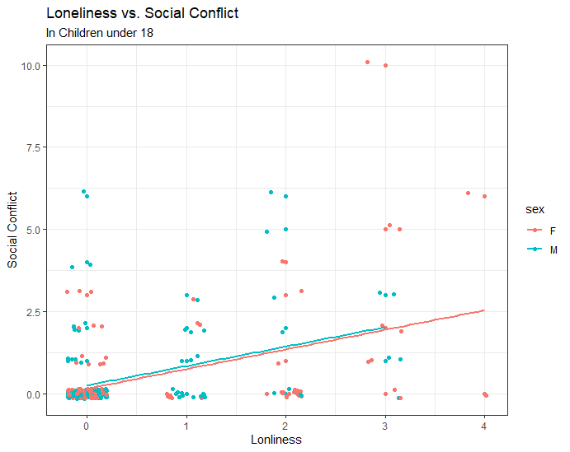
Loneliness and Social Conflict in Children
Similar trend in children
Data pool much smaller

Slide 8
Loneliness and Social Conflict Future Work
Loneliness impact on mental health.
Better recognize social conflict’s affect on mental health.
Can Machine learning be applied to accurately predict loneliness in individuals?

Slide 9
Household Income and household dangers
Income reported by “Tell me about yourself Answer 6” TM_6
LESS_THN_10K;
MORE_THN_10_LESS_THEN_15K
MORE_THN_15_LESS_THEN_20K
MORE_THN_20_LESS_THEN_25K
MORE_THN_25_LESS_THEN_35K
MORE_THN_35_LESS_THEN_50K
MORE_THN_50_LESS_THEN_75K
MORE_THN_75K
Household Danger measured by Core Need Living Situation answer 2
Do you have problems with…? [1] Yes, [2] No, [7] Total
Bug Infestation
Mold
Lead Paint
Inadequate Heat
Oven not Working
Smoke Detector not Working
Water Leaks

Slide 10
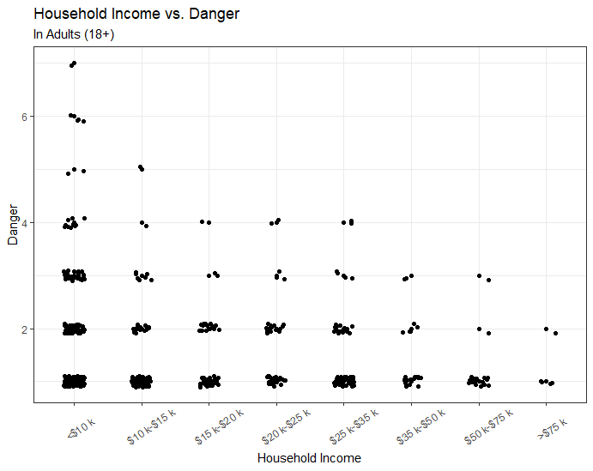
Household Income and Household Dangers
Less Income = More Danger
Only Maximum danger came from Lowest Income

Slide 11
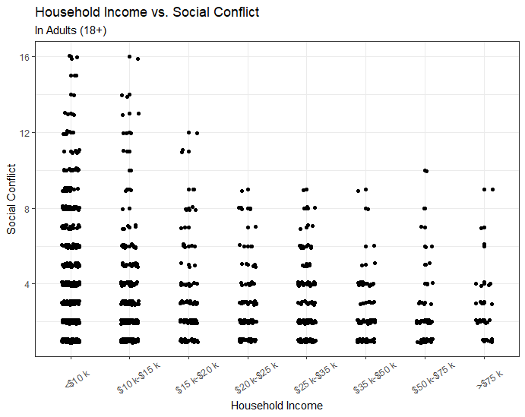
Household Income and Social Conflict
Not as strong of a correlation
Plateaus after $20k

Slide 12
Household Income Future work
Income can be a large factor in overall individual health. (Food/Transportation/Housing)
Income relative to County Blocks
Identify low income populations to better target social services

Slide 13
Tools / Resources
Tools
R/Rstudio
Ggplot2
Dplyr
Knitr
Excel
Resources
Instructions.docx
Interview_data.csv
Interview_data_dict.csv
Accountable Health Communities Model Screening Tool.docx
www.Census.gov (Mesa County Population estimates)

Slide 14
Rmarkdown / Github
Similar presentation written Rmarkdown for reproducibility
Rmarkdown link
Download or view all code at [github link]

Slide 15

Thank you
Questions?

